Slide 1
Stroke prevention in general practice
An RACGP accredited CPD activity
Online module 1

Slide 2
Learning outcomes
At the conclusion of the full educational program, participants will be able to:
Describe the serious burden of stroke in Australia and the challenges that need to be overcome to reduce this burden
Proactively identify patients at increased risk of stroke within their practice
Implement guideline-based management approaches to reduce risk of stroke in both patients at risk for stroke and in those who have had a prior stroke
Triage patients with acute stroke to help ensure optimal outcomes
Develop practical strategies within their practice to ensure F.A.S.T. awareness

Slide 3
Module 1
Thank you for participating in this accredited CPD program. You will need to complete all three modules to receive your CPD points.
Module 1 uses a hypothetical case study to examine stroke risk factors and their management in general practice. This online module should take 1 hour to complete.
Please ensure you complete the reflection activities described throughout module 1, as these are an important part of the program and will be revisited during the next modules.
Contents
Stroke in Australia
Stroke outcomes
Stroke risk factors
Case study
Assessing absolute CV risk
Managing stroke risk factors
Case study hypotheticals

Slide 4
Stroke in Australia

Slide 5
Stroke facts and figures
Stroke is the third-leading cause of death in Australia¹
In 2020, there were >445,000 Australians living with the effects of stroke²
1st
Ischaemic heart disease
2nd
Dementia, including vascular dementia and Alzheimer’s
>
4
4
5
0
0
0
3rd
Cerebrovascular disease
Two in three stroke survivors are dependent on another person for their daily needs³
The financial cost of stroke in Australia was estimated to be $6.2 billion in 2020⁴
$6.2 billion
1. Australian Bureau of Statistics. Causes of death, 2020. Available from: www.abs.gov.au/Causes-of-Death. Accessed January 2022. 2. Stroke Foundation. No postcode untouched. Stroke in Australia in 2020. Available from: https://strokefoundation.org.au/What-we-do/Research/No-postcode-untouched. Accessed January 2022. 3. Stroke Foundation. Available at: https://strokefoundation.org.au/What-we-do/Prevention-programs/Position%20and%20submissions. Accessed January 2022. 4. Deloitte Access Economics. 2020. The economic impact of stroke in Australia, 2020.

Slide 6
How many Australians experience stroke?
Estimate how many of these 45-year old men will have a stroke by the age of 85 years
Estimate how many of these 45-year old women will have a stroke by the age of 85 years

Slide 7
How many Australians experience stroke?
Estimate how many of these 45-year old men will have a stroke by the age of 85 years
Estimate how many of these 45-year old women will have a stroke by the age of 85 years
For a 45-year-old man, the risk of having a stroke by age 85 is 1 in 4¹
For a 45-year-old woman, the risk of having a stroke by age 85 is 1 in 5¹
1. Brain Foundation. Stroke. Available from: https://brainfoundation.org.au/disorders/stroke/. Accessed January 2022.

Slide 8
Stroke risk in regional vs metropolitan Australia
Regional Australians are 17% more likely to suffer a stroke than those in metropolitan areas¹
↑17%
1. Stroke Foundation. No postcode untouched. Stroke in Australia in 2020. Available from: https://strokefoundation.org.au/What-we-do/Research/No-postcode-untouched. Accessed January 2022.

Slide 9
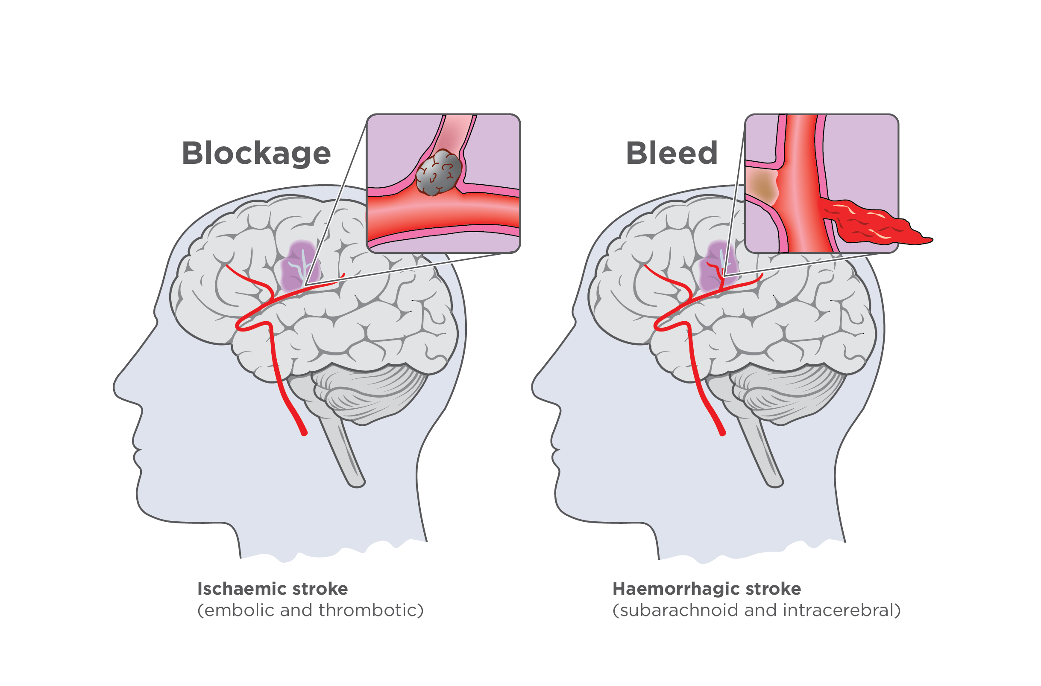
Types of stroke: ischaemic and haemorrhagic stroke^{1,2}
~80% of all strokes¹
~20% of all strokes¹
1. Davies L, Delcourt C. Intern Med J 2021;51:481–7. 2. Stroke Foundation. Types of stroke. Available at: https://enableme.org.au/resources/types-of-stroke. Accessed January 2022.
Notes:
Images from Stroke Foundation:

Slide 10
Stroke outcomes

Slide 11
Time is brain for patients with ischaemic stroke^{1,2}
For each minute without treatment, patients lose:¹
1.9 million neurons
14 billion synapses
12 km myelinated fibers
Thrombolysis should be administered to eligible patients as early as possible after stroke onset, up to 4.5 hours of onset of symptoms for
patients with potentially
disabling ischaemic stroke who
meet specific eligibility criteria²
This means that 15 minutes delay to treatment in the ED costs a patient 28.5 million neurons, which is associated with accelerated brain ageing of almost 1 year (46.5 weeks)¹
Thrombolysis can restore blood flow before major brain damage has occurred²
1. Saver JL. Stroke 2006;37:263–6. 2. Stroke Foundation. Clinical Guidelines for Stroke Management, 2020. Available at: https://informme.org.au/en/Guidelines/Clinical-Guidelines-for-Stroke-Management. Accessed January 2022.

Slide 12
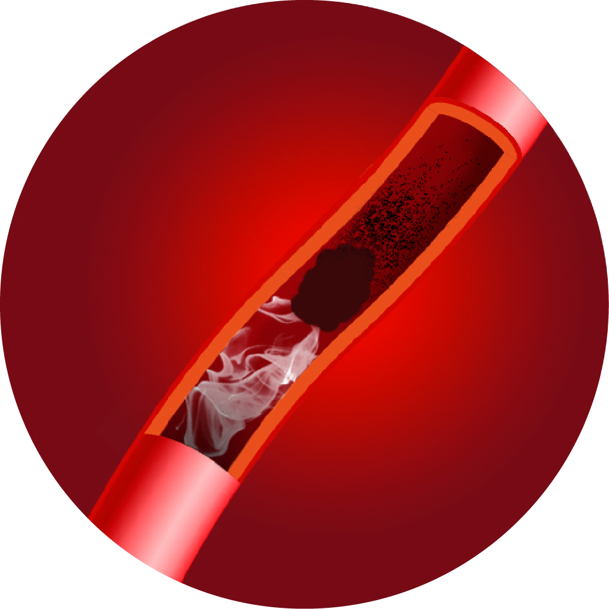
Reperfusion therapies¹⁻⁵
Approximately 30% of AIS patients present with an LVO within 6 hours of symptom onset^{4,5}
Approximately 35% of AIS patients may be eligible for thrombolysis¹
+/–
Endovascular Thrombectomy
Thrombolysis
Systemic pharmaceutical intervention intended to dissolve a thrombus in eligible AIS patients²
Surgical technique to mechanically reperfuse an occluded vessel. Used in eligible AIS patients in whom a large vessel occlusion is present (usually following thrombolysis)³
Acute stroke management will be discussed in more detail in Module 2
Thrombolysis is time-dependent: earlier treatment is linked to better patient outcomes²
AIS = acute ischaemic stroke; LVO = large vessel occlusion
1. Vanacker P, et al. Stroke 2016. 2. Actilyse® Product Information. January 2021. 3. Stroke Foundation. Clinical Guidelines for Stroke Management, 2020. Available at: https://informme.org.au/en/Guidelines/Clinical-Guidelines-for-Stroke-Management. Accessed January 2022. 4. Beumer D, et al. Neurovascular Imaging 2016. 5. Malhotra et al. Front Neurol 2017.

Slide 13
Outcomes of stroke at 1 year¹
For every 100 people who have a stroke:
30 die within 12 months* (15–20 within 30 days)
35 permanently disabled (10 in nursing home)
25 independent but not able to do everything they could do previously
10 fully recovered
*ICH/SAH has a 50% mortality rate at 1 year and ischaemic stroke has a 15% mortality rate.
1. Brain Foundation. Stroke. Available from https://brainfoundation.org.au/disorders/stroke/. Accessed January 2022.

Slide 14
Stroke has serious potential long-term complications¹
Weakness or lack of movement (paralysis) in legs and/or arms
Trouble speaking, reading or writing
Changes to the way things are felt when touched (sensory problems)
Problems thinking or remembering (cognitive problems)
Changes to way things are seen or felt (perceptual problems)
Shoulder pain
Trouble swallowing
Incontinence
Feeling depressed
Problems controlling feelings
Tiredness / fatigue
1. Brain Foundation. Stroke. Available from https://brainfoundation.org.au/disorders/stroke/. Accessed January 2022.

Slide 15
Stroke risk factors

Slide 16
Modifiable risk factors for ischaemic and haemorrhagic stroke¹
Modifiable risk factors | Ischaemic | Haemorrhagic
Hypertension* | ✓✓ | ✓ ✓✓
Current smoking | ✓ | ✓
Waist-to-hip ratio | ✓✓ | ✓
Poor diet | ✓✓ | ✓✓
Physical inactivity | ✓✓ | ✓✓
Alcohol consumption high | ✓ | ✓
Apolipoproteins B/A1 | ✓✓ | –
Diabetes mellitus | ✓ | –
Psychosocial stress | ✓ | ✓✓
Cardiac causes† | ✓ | –
10 risk factors are associated with 90% of risk
in age- and gender-matched populations
Population-attributable risk (PAR):
✓✓✓ PAR 50–74%
✓✓ PAR 20–49%
✓ PAR <20%
*History of hypertension or BP >160/90 mmHg.
†Includes atrial fibrillation or flutter, previous myocardial infarction, rheumatic valve disease, or prosthetic heart valve.
Atrial fibrillation (AF) is associated with a ~5x increased risk of ischaemic stroke
1. O’Donnell MJ et al. on behalf of INTERSTROKE investigators. Lancet 2016; 388:761–75.

Slide 17
Non-modifiable risk factors for stroke¹
Age
Stroke incidence increases with age¹
Doubling each decade after 55 years of age¹
Incidence and prevalence of ischaemic stroke increasing in those aged <54 years²
14% in 2012 vs 24% in 2020²
Ethnicity
Age-standardised stroke incidence was over 3-fold greater in Indigenous vs non-Indigenous Australians (104 vs 33 per 100,000; p<0.001)³
Median age of incident stroke was 44 years in Indigenous Australians, 29 years younger than in non-Indigenous Australians; p<0.001)³
Gender
More strokes in women, due to longer life span¹
Risk impacted by age:¹
Younger women have similar or higher risk vs younger men
Older men have slightly higher risk vs older women
Genetics
Certain risk factors may have a genetic basis e.g. atrial fibrillation, diabetes, hypertension¹
1. Boehme A et al. Circ Res. 2017;120:472-495. 2. Deloitte Access Economics. 2020. No postcode untouched, Stroke in Australia 2020. 3. Dos Santos A et al. Heart Lung Circ 2019;28:S56. 4. Stroke Foundation. Clinical Guidelines for Stroke Management, 2020. Available at: https://informme.org.au/en/Guidelines/Clinical-Guidelines-for-Stroke-Management. Accessed January 2022.

Slide 18
GPs are uniquely placed to play a key role in stroke prevention¹
More than 80% of strokes are preventable²
Prevention requires proactive identification of patients who are at increased risk of stroke and systematic implementation of guideline-based management approaches to manage risk factors¹
1. Lyons A. RACGP Good Practice. Stroke: stealth attack. September 2017. Available at: https://www.racgp.org.au/download/Documents/Good%20Practice/2017/September/GP2017-Sep-stroke.pdf. Accessed January 2022. 2. O’Donnell M et al. Lancet 2016;388:761–75.

Slide 19
Reflections Note down your reflections
What are you doing currently in your practice to identify patients at risk of stroke?
What are you currently doing to ensure your at-risk patients do not have a stroke?
What more could you do to protect them?

Slide 20
Hypothetical Case Study David, 62 years old
Patient featured is not an actual patient
David has just moved to the area and visits your practice for the first time.
Having seen the Heart Foundation campaign, Know your heart age, he requests a healthy heart check.

Slide 21
Reflection
Before progressing, take a moment to consider how cardiovascular health is assessed and stroke risk identified in your practice.
How likely is this scenario? Do patients in your practice make appointments for a cardiovascular health check up?
What can you do to encourage patients to come in for a cardiovascular health check up?
What kind of patients (age, ethnicity, gender) would you perform a cardiovascular health review on during a standard consultation (i.e. when the patient visits for another reason)?
What cardiovascular risk factors do you consider?
What systems do you have in place to ensure cardiovascular health is assessed for all appropriate patients?

Slide 22
Heart Health Check – MBS item 699¹
Heart health assessment by a GP lasting at least 20 minutes; must include:
Patient history
Identify cardiovascular disease risk factors, including:
diabetes status
alcohol intake
smoking status
blood glucose
Physical examination
Must include
blood pressure
cholesterol status
Check pulse manually to assess for irregular heartbeat (not listed as part of MBS item 699)
Other relevant health assessment MBS item numbers:
701
703
705
707
Assessment
Initiate interventions and referrals to address the identified risk factors
Implement a management plan for appropriate treatment of identified risk factors
Provide preventative healthcare advice and information, including modifiable lifestyle factors
Management
Eligibility criteria: People who are: aged 40-49 years (inclusive) with a high risk of developing type 2 diabetes (as determined by the Australian Type 2 Diabetes Risk Assessment Tool); or aged 45 to 49 (inclusive) who are at risk of developing a chronic disease, or aged 75 years and older; or who are permanent residents of a Residential Aged Care Facility; or who have an intellectual disability; or who are humanitarian entrants who are resident in Australia with access to Medicare services, including Refugees and Special Humanitarian Program and Protection Program entrants; or who are former serving members of the Australian Defence Force including former members of permanent and reserve force.
1. Australian Government Department of Health Medicare Benefits Schedule. MBS Online http://www.mbsonline.gov.au/. Accessed January 2022.

Slide 23
Case study – history & examination
During the consultation, David mentions that he’s worried he will end up the same as his dad – David’s father had a stroke at the age of about 60 years, which left him partially disabled and dependent on the care of David’s mum. His father died aged 62, following a second stroke.
HISTORY
Tobacco use: Ex-smoker (quit 20 years ago)
Alcohol: 2–3 glasses of wine about 4–5 times a week
Physical activity: Cancelled gym membership 5 years ago, walks the dog occasionally
Medical history: No prior medical history
Diet: Reasonably well-balanced diet
Medication: None
EXAMINATION
Blood pressure: 160/100 mmHg
Pulse: 72bpm, regular
BMI: 29 kg/m²
Waist-to-hip ratio: 0.95
Proteinuria: none
DAVID
62 years old
Patient featured is not an actual patient.

Slide 24
Case study – pathology results
David returns for a follow-up consultation once pathology test results are available. In the meantime, he checks his blood pressure for a few days using a home blood pressure monitor.
PATHOLOGY
Cholesterol:
Total 6.6 mmol/L LDL-C 4.2 mmol/L HDL-C 1.1 mmol/L TG 2.8 mmol/L
Blood glucose: 6.3 mmol/L (pre-diabetes)
Kidney function: Normal
Liver function: Normal
BLOOD PRESSURE
Office blood pressure: 164/100 mmHg
Pulse: 75bpm, regular
Mean home blood pressure:148/96 mmHg
DAVID
62 years old

Slide 25
Reflection
Before progressing, take a moment to consider how often you see patients with risk factors for stroke (or cardiovascular disease)
List any stroke (or cardiovascular disease) risk factors identified for David so far
Consider how many patients with these risk factors you have seen in your practice in the past 4 weeks

Slide 26
David’s risk factors for stroke
Modifiable risk factors | David
Hypertension | ✓
Current smoking
Waist-to-hip ratio | ✓
Poor diet
Physical inactivity | ✓
Diabetes mellitus
Alcohol consumption
Psychosocial stress
Cardiac causes | –
Ratio of apolipoproteins B to A1 | ?
Non-modifiable risk factors | David
Age | ✓
Female gender
Ethnicity
Genetics | ?
What does this information tell you about David’s risk of stroke?
Is he at high, medium or low risk of an event?

Slide 27
Assessing absolute cardiovascular risk

Slide 28
Cardiovascular disease risk assessment
64% of the adult population in Australia have three or more modifiable risk factors for CVD¹
“Assessment of cardiovascular disease (CVD) risk on the basis of the combined effect of multiple risk factors (absolute CVD risk) is more accurate than the use of individual risk factors, because the cumulative effects of multiple risk factors may be additive or synergistic.”¹
1. National Vascular Disease Prevention Alliance. Guidelines for the management of Absolute cardiovascular disease risk. 2012.

Slide 29
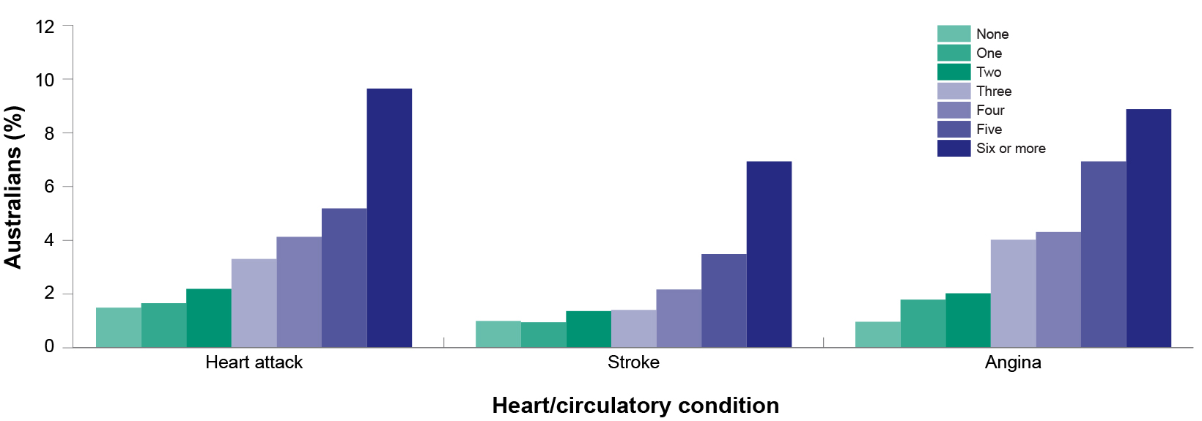
Having more than one risk factor magnifies the risk of disease¹
Prevalence of selected heart/circulatory conditions by number of risk factors* reported among Australians aged ≥18 years, 2001¹
*Risk factors include obesity, high blood pressure, high blood cholesterol, diabetes, physical inactivity, smoking, risky alcohol consumption, low vegetable consumption and low fruit consumption.
Adapted from: 1. AIHW: O’Brien K 2005. Living dangerously: Australians with multiple risk factors for cardiovascular disease. Bulletin No. 24. AIHW Cat. No. AUS 57. Canberra: AIHW.

Slide 30
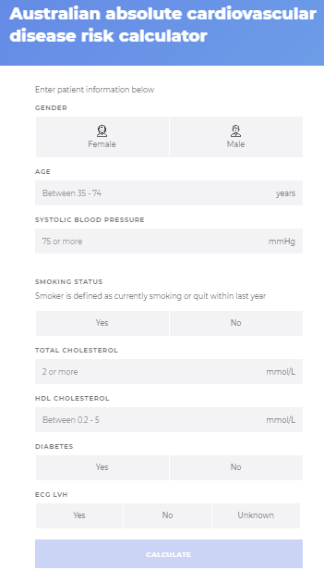
Australian absolute CVD risk calculator¹
Predicts the risk of a CV event over the next 5 years using the Framingham Risk Equation
Use for all adults aged 45 and older (35 years and older for Aboriginal and Torres Strait Islander peoples*) without existing cardiovascular disease or not already known to be at increased risk of cardiovascular disease
For specific population groups, additional recommendations include:
Conduct assessments in adults with diabetes aged 45–60 years (rather than 45–74 years)*
The Framingham Risk Equation has not been specifically assessed in adults who are overweight or obese
In adults with atrial fibrillation (particularly those aged >65 years), an increased risk of cardiovascular events and all-cause mortality, in addition to thromboembolic disease and stroke, should be considered. Clinical judgement is necessary when assessing overall cardiovascular risk
cvdcheck.org.au
Note: there will be updates on the calculator later in the year
Atrial fibrillation is associated with 5-fold increased risk for ischaemic stroke,² highlighting the importance of long-term non-vitamin K antagonist (NOAC) therapy³
*Framingham Risk Equation might underestimate risk in this population; available evidence suggests that this approach will provide an estimate of minimum cardiovascular risk.¹
1. Australian absolute cardiovascular disease risk calculator. Available from: http://www.cvdcheck.org.au/for-health-professionals. Accessed January 2022. 2. O’Donnell MJ et al. on behalf of INTERSTROKE investigators. Lancet 2016; 388: 761–75. 3. Brieger D et al. National Heart Foundation of Australia and the Cardiac Society of Australia and New Zealand: Australian Clinical Guidelines for the Diagnosis and Management of Atrial Fibrillation 2018. Heart Lung Circ 2018;27:1209–1266.

Slide 31
Australian absolute cardiovascular disease risk calculator¹
Clinically-determined high risk groups
Adults already known to be at increased absolute risk of cardiovascular disease who do not require CVD risk calculation
Diabetes and age >60 years
Diabetes with microalbuminuria (>20 mcg/min or UACR >2.5 mg/mmol for males, >3.5 mg/mmol for females)
Moderate or severe chronic kidney disease (persistent proteinuria or eGFR <45 mL/min/1.73m²)
A previous diagnosis of familial hypercholesterolaemia
Systolic blood pressure ≥180 mmHg or diastolic blood pressure ≥110 mmHg
Serum total cholesterol >7.5 mmol/L
Aboriginal and Torres Strait Islander adults aged >74 years
A more recent consensus statement recommends:²
“From age 18 years (at the latest), Aboriginal and Torres Strait Islander adults should undergo CVD risk factor screening, and from age 30 years (at the latest), they should undergo absolute CVD risk assessment using the NVDPA risk algorithm.”
eGFR, estimated glomerular filtration; UACR, urinary albumin:creatinine ratio.
31
1. National Vascular Disease Prevention Alliance. Guidelines for the management of Absolute cardiovascular disease risk. 2012. 2. Agostino JW et al. Med J Aust 2020;212;422–7.

Slide 32
Why assess absolute CV risk?¹
To identify other modifiable risk factors that require management
To predict who will benefit most from intervention and determine the appropriate management plan
To enable the patient to understand the degree of urgency for modifying risk factors
In contrast, relative risk is a ratio of the rate of events in the population exposed to a risk factor compared with the rate among the population not exposed to this risk factor. It tells you little about your patient’s actual risk²
1. National Heart Foundation of Australia (National Blood Pressure and Vascular Disease Advisory Committee). Guide to management of hypertension 2008. Updated December 2010. 2. National Vascular Disease Prevention Alliance. Guidelines for the management of absolute cardiovascular disease risk. 2012.

Slide 33
Exercise
Use the Australian absolute cardiovascular disease risk calculator to calculate David’s risk
Try entering different values for blood pressure, lipids, smoking status and diabetes
How does this affect his level of risk?
DAVID
62 years old

Slide 34
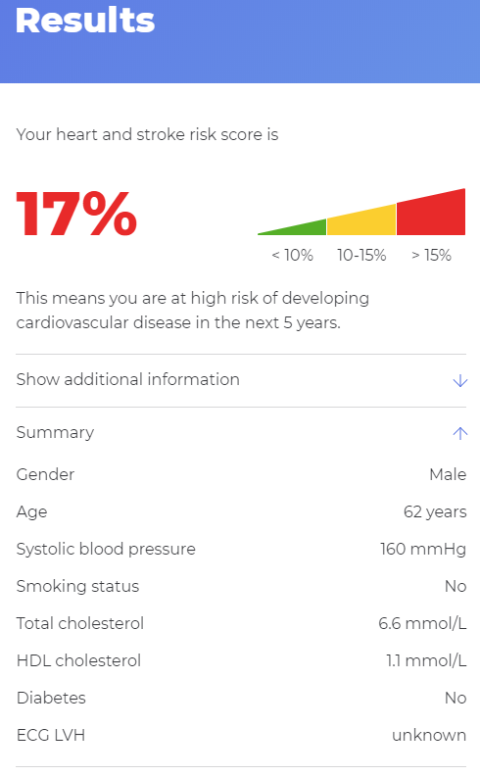
Case study: David’s absolute CV risk
DAVID
62 years old

Slide 35
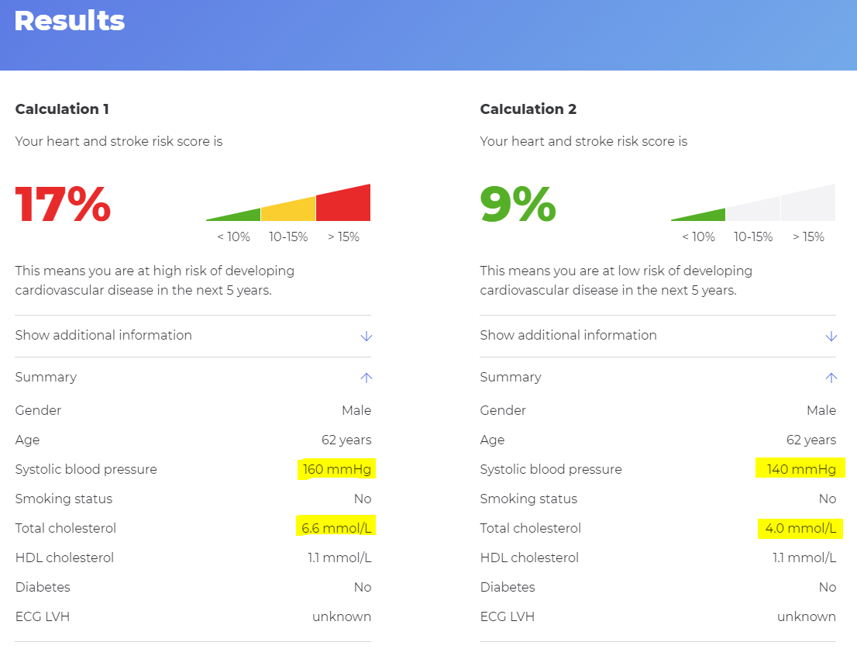
Case study: Absolute CV risk
DAVID
62 years old

Slide 36
Managing risk factors

Slide 37
Management of absolute CVD risk¹
Risk factor 1
Risk factor 1
Moderate reductions in several risk factors is considered more effective in reducing overall CVD risk than a major reduction in just one factor
Risk factor 2
Risk factor 3
1. National Vascular Disease Prevention Alliance. Guidelines for the management of Absolute cardiovascular disease risk. 2012.

Slide 38
Lifestyle – physical activity¹
Age | What should be done? | How often?
Adults aged 18–64 years | Ask questions regarding current level of activity and sedentary behaviour, and assess against current guidelines (II, A). Recommend doing some activity on most days of the week. Accumulate 2.5-5 hours of moderate intensity physical activity. 1.25-2.5 hours of vigorous intensity physical activity, or a combination of these per week (III, A). Do muscle strengthening activities at least 2 days a week (I, A). Avoid prolonged sitting and break up periods of sitting (III, C). | Every 2 years (III, C)
People aged ≥65 years | Ask questions regarding current level of activity and sedentary behaviour, and assess against current guidelines (II, A). Recommend some physical activity every day that improves fitness, strength, balance and flexibility (III, C). Accumulate at least 30 minutes of moderate activity on most days (III, C). | Every 2 years
Regular physical activity is a mainstay of CV prevention; participation decreases all-cause and CV mortality as well as increasing fitness and improving mental health²
1. The Royal Australian College of General Practitioners. Guidelines for preventive activities in general practice. 9th edn, updated. East Melbourne, Vic: RACGP, 2016. 2. Visseren FLJ et al. 2021 European guidelines on cardiovascular disease prevention in clinical practice. Eur J Prev Cardiol 2021 Sep 24:zwab154. doi: 10.1093/eurjpc/zwab154. Online ahead of print.

Slide 39
Lifestyle – diet
Characteristics of a healthy diet:¹
Adopt a more plant- and less animal-based food pattern
Saturated fatty acids should account for <10% of total energy intake, through replacement by PUFAs, MUFAs, and carbohydrates from whole grains
Trans unsaturated fatty acids should be minimized as far as possible, with none from processed foods
<5 g total salt intake per day
30–45 g of fibre of per day, preferably from wholegrains
≥200 g of fruit per day (≥2–3 servings)
≥200 g of vegetables per day (≥2–3 servings)
Red meat should be reduced to a maximum of 350 − 500 g a week, in particular processed meat should be minimized
Fish is recommended 1–2 times per week, in particular fatty fish
30 g unsalted nuts per day
Consumption of alcohol should be limited to a maximum of 100 g per week
Sugar-sweetened beverages, such as soft drinks and fruit juices, must be discouraged
Following a Mediterranean diet over 5 years was associated with a 29% lower risk of CVD [RR 0.71 (95% CI 0.56, 0.90)], compared with a control diet in high-risk individuals²
MUFA = monounsaturated fatty acid; PUFA = polyunsaturated fatty acid.
1. Visseren FLJ et al. 2021 European guidelines on cardiovascular disease prevention in clinical practice. Eur J Prev Cardiol 2021 Sep 24:zwab154. doi: 10.1093/eurjpc/zwab154. Online ahead of print. 2. Estruch R et al. N Engl J Med 2013;368:1279–90.

Slide 40
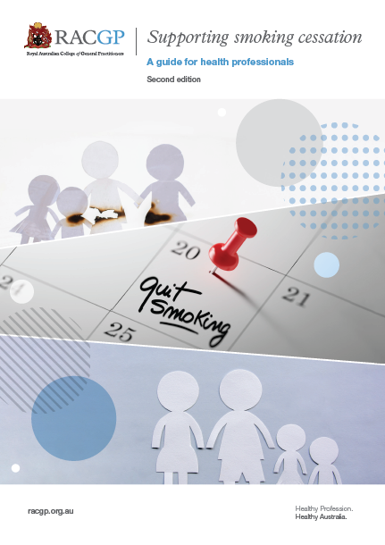
Smoking cessation is the most cost-effective strategy for preventing CVD¹
RACGP Supporting Smoking Cessation: A guide for health professionals
A brief intervention with advice to stop smoking, plus assistance with stopping using drug therapy and follow-up support can be effective
“Five As” smoking cessation strategy for routine practice (see next slide)
1. The Royal Australian College of General Practitioners. Supporting smoking cessation: A guide for health professionals. 2nd edn. East Melbourne, Vic: RACGP, 2019.

Slide 41
“Five As” smoking cessation strategy for routine practice¹
Ask
Ask about and document the smoking status of all patients
Assess
Assess nicotine dependence
How many minutes to first cigarette after waking? (Smoking within 30 minutes indicates nicotine dependence.)
Assess and address barriers to quitting
Advise
In a way that is clear but is non-confrontational, advise all patients who smoke to quit
‘The best thing you can do for your health is to quit smoking’
Assist
Offer smoking cessation assistance and, if the person is willing to accept the offer, affirm and encourage them
Agree on a quit plan, including agreeing on a quit day, strategies for managing smoking triggers and barriers to success, and mobilising social support
Recommend pharmacotherapy if nicotine dependent
If the patient is not ready or unsure, use motivational approach, explore barriers and review at future visits
5As treatment pathway
Arrange
For patients making a quit attempt, arrange follow-up contact starting within a week of the quit day
Congratulate and encourage
Review progress and problems
Encourage continued use of pharmacotherapy
Monitor and manage medication side effects
1. The Royal Australian College of General Practitioners. Supporting smoking cessation: A guide for health professionals. 2nd edn. East Melbourne, Vic: RACGP, 2019.

Slide 42
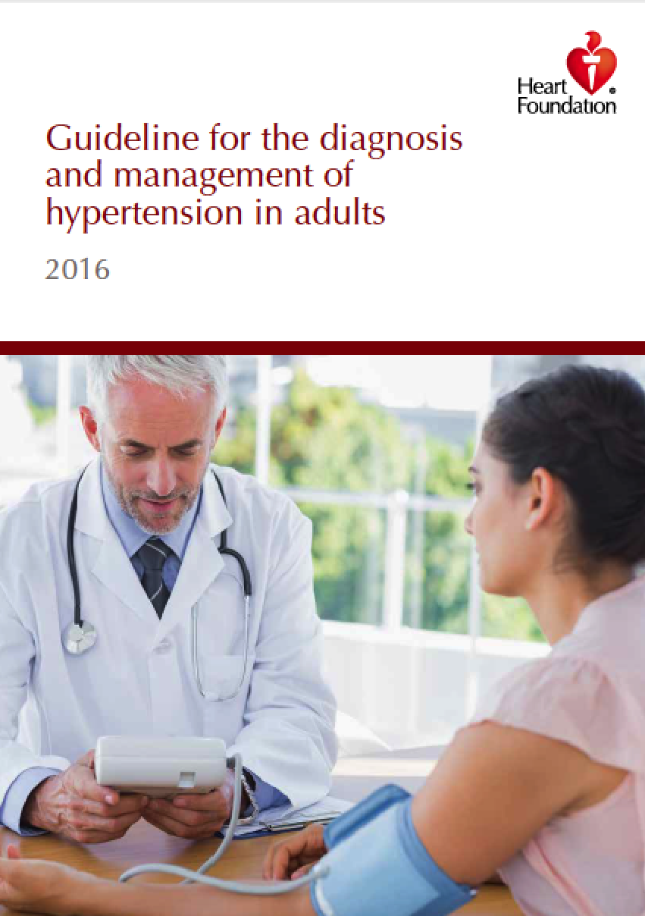
Hypertension management recommendations¹
Recommendations for treatment strategies and treatment targets for patients with hypertension
Recommendations for treatment strategies and treatment targets for patients with hypertension | Graded of recommendation | Level of evidence
a. Lifestyle advice is recommended for all patients. | Strong
b. For patients at low absolute CVD risk (<10% 5-year risk) with persistent blood pressure ≥160/100 mm Hg, anti-hypertensive therapy should be started. | Strong | I
c. For patients at moderate absolute CVD risk (10-15% 5-year risk) with persistent blood pressure ≥140 mmHg systolic and/or ≥90 mmHg diastolic, antihypertensive therapy should be started. | Strong | I
d. Once decided to treat, patients with uncomplicated hypertension should be treated to a target of <140/90 mmHg or lower if tolerated. | Strong | I
e. In selected high CV risk populations where a more intense treatment can be considered, aiming to a target of <120 mmHg systolic blood pressure can improve cardiovascular outcomes. | Strong | II
f. In selected high CV risk populations where a treatment is being targeted to <120 mmHg systolic, close follow-up of patients is recommended to identify treatment related adverse effects including hypotension, syncope, electrolyte abnormalities and acute kidney injury. | Strong | II
g. In patients with uncomplicated hypertension ACE inhibitors or ARBs, calcium channel blockers, and thiazide diuretics are all suitable first-line antihypertensive drugs, either as monotherapy or in some combinations unless contraindicated. | Strong | I
h. The balance between efficacy and safety is less favourable for beta-blockers than other first-line anti hypertensive drugs. Thus beta-blockers should not be offered as a first-line drug therapy for patients with hypertension not complicated by other conditions. | Strong | I
i. ACE inhibitors and ARBs are not recommended in combination due to the increased risk of adverse effects. | Strong | I
National Heart Foundation of Australia. Guideline for the diagnosis and management of hypertension in adults – 2016
1. National Heart Foundation of Australia. Guideline for the diagnosis and management of hypertension in adults – 2016. Melbourne: National Heart Foundation of Australia, 2016.

Slide 43
Dyslipidaemia management recommendations¹
2019 ESC/EAS Guideline Recommendations for the Management of Dyslipidaemias
Treatment goals for LDL-C
In secondary prevention for patients at very-high risk. an LDL-C reduction of ≥50% from baseline and an LDL-C goal of <1.4 mmol/L are recommended. |  | I | A
In primary prevention for individuals at very-high risk, an LDL-C reduction of ≥50% from baseline and an LDL-C goal of <1.4 mmol/L are recommended. |  | I | C
In patients at high risk, an LDL-C reduction of ≥50% from baseline and an LDL-C goal of <1.8 mmol/L are recommended. |  | I | A
Pharmacological LDL-C lowering
It is recommended that a high-intensity statin is prescribed up to the highest tolerated dose to reach the goals set for the specific level of risk. | I |  | A
If the goals are not achieved with the maximum tolerated dose of a statin, combination with ezetimibe is recommended. | I |  | B
For secondary prevention in patients at very-high risk not achieving their goal on a maximum tolerated dose of a statin and ezeti­mibe, a combination with a PCSK9 inhibitor is recommended. | I |  | A
For very-high-risk FH patients (that is, with ASCVD or with another major risk factor) who do not achieve their goal on a maxi­mum tolerated dose of a statin and ezetimibe, a combination with a PCSK9 inhibitor is recommended. | I |  | C
ªClass of recommendation. ^{b}Level of evidence.
Note: these recommendations differ from PBS eligibility criteria for cholesterol-lowering medicines. See https://www.pbs.gov.au/info/news/2006/09/Eligibility-cholestl-lwring-meds/ for details.
1. Mach F et al. 2019 ESC/EAS Guidelines for the Management of Dyslipidaemias: Lipid Modification to Reduce Cardiovascular Risk. Eur Heart J 2020; 41: 111–88.

Slide 44
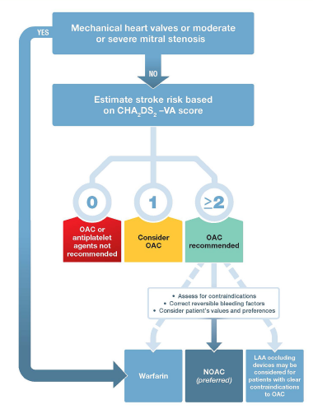
Atrial fibrillation management recommendations¹
AF is one of the major causes of stroke, heart failure, sudden death and CV morbidity
Stroke risk should be assessed in all patients using the CHA₂DS₂-VA score and anticoagulation initiated as appropriate
A NOAC is generally the preferred option
Stroke prevention in AF
Score | Points | Definition
C | 1 | Congestive heart failure—recent signs, symptoms or admission for decompensated heart failure; this includes both HFrEF and HFpEF, or moderately to severely reduced systolic left ventricular function, whether or not there is a history of heart failure
H | 1 | History of hypertension, whether or not BP is currently elevated
A₂ | 2 | Age ≥75 years
D | 1 | Diabetes
S₂ | 2 | History of prior Stroke or TIA or systemic thromboembolism
V | 1 | Vascular disease, deﬁned as prior myocardial infarction or peripheral arterial disease or complex aortic atheroma or plaque on imaging (if performed)
A | 1 | Age 65–74 years
BP, blood pressure; HFpEF, heart failure with preserved ejection fraction; HFrEF, heart failure with reduced ejection fraction; LAA, left atrial appendage; NOAC, Non-vitamin K oral anticoagulant (apixaban, dabigatran, rivaroxaban); OAC, oral anticoagulant; TIA, transient ischaemic attack.
Adapted from: Brieger et al. 2018¹
1. Brieger D et al. National Heart Foundation of Australia and the Cardiac Society of Australia and New Zealand: Australian Clinical Guidelines for the Diagnosis and Management of Atrial Fibrillation 2018. Heart Lung Circ 2018; 27: 1209–1266.

Slide 45
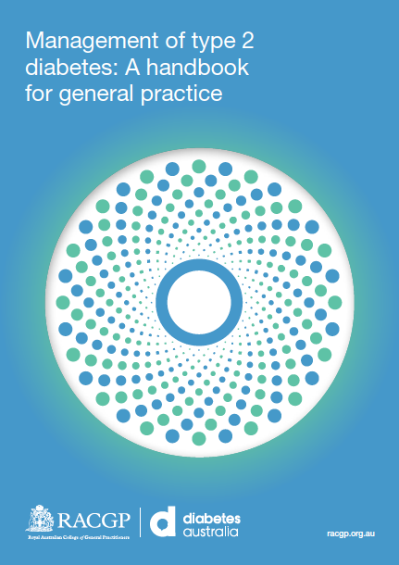
Type 2 diabetes management recommendations¹
CVD is the leading cause of death in people with diabetes, making assessment, prevention and management of CVD risk a vital part of diabetes care
Large-scale CV outcomes studies have demonstrated cardio- and renal-protection with some glucose-lowering therapies (SGLT2 inhibitors and GLP-1 receptor antagonists)²
2020 RACGP type 2 diabetes handbook now available
Managing CVD risk in patients with type 2 diabetes
Adults at high absolute risk of CVD should be simultaneously treated with lipid and blood pressure–lowering pharmacotherapy in addition to lifestyle advice, unless contraindicated or clinically inappropriate | 1 NVDPA, 2012 | B
Sodium glucose co-transporter 2 (SGLT2) inhibitors are recommended in patients with type 2 diabetes in the setting of CVD and insufficient glycaemic control despite metformin, to decrease the risk of cardiovascular events and decrease the risk of hospitalisation for heart failure | 3 Heart Foundation, 2018 | Strong; high-quality evidence
1. The Royal Australian College of General Practitioners. Management of type 2 diabetes: A handbook for general practice. East Melbourne, Vic: RACGP, 2020.

Slide 46
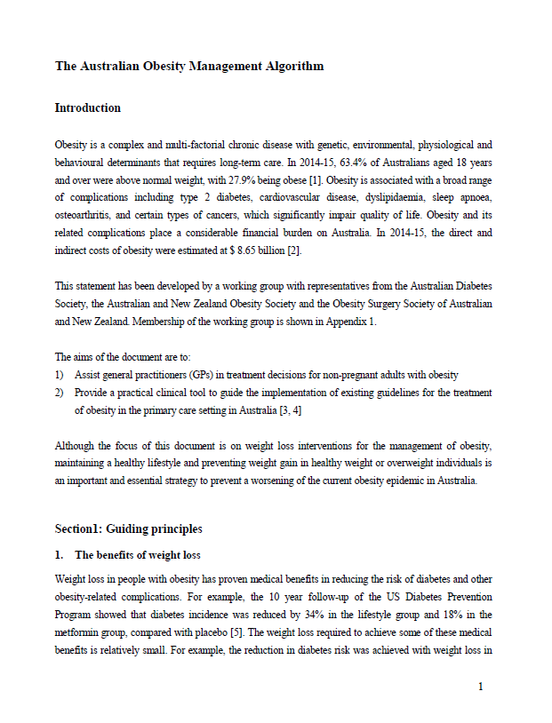
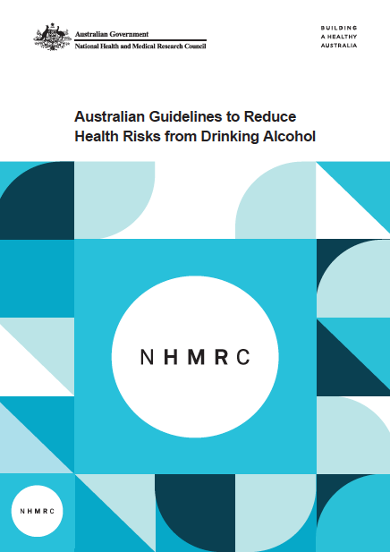
Other risk factors
Alcohol¹
Australian guidelines (2020) recommend:
To reduce the risk of harm from alcohol-related disease or injury in healthy men and women:
No more than 10 standard drinks per week
No more than 4 standard drinks on any one day
Weight (waist-to-hip ratio)²
Australian Obesity Management Algorithm options include:
Diet and lifestyle interventions
Low energy or very low energy diets with meal replacement
Pharmacotherapy
Bariatric surgery
1. NHMRC. Australian guidelines to reduce health risks from drinking alcohol. Available at: https://www.nhmrc.gov.au/health-advice/alcohol. Accessed January 2022. 2. Australian Diabetes Society. The Australian Obesity Management Algorithm. Available at: https://diabetessociety.com.au/documents/ObesityManagementAlgorithm18.10.2016FINAL.pdf. Accessed January 2022.

Slide 47
Case study hypotheticals

Slide 48
Case study: David’s management
David is at high risk of a CV event, and his high blood pressure puts him at increased risk of stroke.
National Vascular Disease Prevention Alliance guidelines for the management of absolute cardiovascular disease risk recommendations for people at high risk of CVD:
Frequent and sustained specific advice and support regarding diet and physical activity
Simultaneous treatment with lipid lowering and BP lowering, unless contraindicated or clinically inappropriate
DAVID
62 years old
Blood pressure
Initiate antihypertensive monotherapy with an ACE inhibitor or angiotensin receptor (ARB), and arrange early follow up. It is likely that David will need a combination of at least two antihypertensive agents (ACE inhibitor or ARB plus a calcium channel blocker [CCB]) to reach a target SBP of 130–140 mmHg.
Lipids
Initiate lipid-lowering therapy with a statin.
Lifestyle
Refer to dietitian for nutritional advice and support for weight loss.
Discuss options for fitting physical activity into daily routine.

Slide 49
What if… David was diagnosed with atrial fibrillation and smoked about 10 cigarettes a day. How would your proposed management differ?
DAVID
62 years old
Hypothetical 1
LIFESTYLE
Tobacco use: Smoker (~10/day)
Alcohol: 2–3 glasses of wine about 4–5 times a week
Physical activity: Cancelled gym membership 5 years ago, walks the dog occasionally
Diet: Reasonably well-balanced diet
EXAMINATION
Blood pressure: 160/100 mmHg
Pulse: Irregular – ECG confirms newly diagnosed atrial fibrillation
BMI: 29 kg/m²
Waist-to-hip ratio: 0.95
Proteinuria: none
Please consider how your management of David would change in this case scenario
Note down your reflections as these case scenarios will be revisited in the next module
PATHOLOGY
Cholesterol:
Total 6.6 mmol/L LDL-C 4.2 mmol/L HDL-C 1.1 mmol/L TG 2.8 mmol/L
Blood glucose: 6.3 mmol/L (pre-diabetes)
Kidney function: Normal
Liver function: Normal

Slide 50
What if… David was 82 years old, living in aged care, and had atrial fibrillation. How would your proposed management differ?
DAVID
Hypothetical 2
LIFESTYLE
Tobacco use: Non-smoker Alcohol: Rarely drinks
Physical activity: Limited
Diet: Reasonably well-balanced diet
EXAMINATION
Blood pressure: 160/100 mmHg
Pulse: 78 bpm, regular
BMI: 27 kg/m²
Waist-to-hip ratio: 0.90
Proteinuria: none
Please consider how your management of David would change in this case scenario
Note down your reflections as these case scenarios will be revisited in the next module
PATHOLOGY
Cholesterol:
Total 6.6 mmol/L LDL-C 4.2 mmol/L HDL-C 1.1 mmol/L TG 2.8 mmol/L
HISTORY Atrial fibrillation diagnosed 20 years ago
Managed with dabigatran and sotalol
Kidney function: eGFR 65 mL/min/1.73m²
Liver function: Normal

Slide 51
What if… David was obese and had obstructive sleep apnoea, type 2 diabetes and chronic kidney disease. How would your proposed management differ?
DAVID
62 years old
Hypothetical 3
LIFESTYLE
Tobacco use: Non-smoker (approximately 10 per day)
Alcohol: 2–3 glasses of wine about 4–5 times a week
Physical activity: Cancelled gym membership 5 years ago, walks the dog occasionally
Diet: Reasonably well-balanced diet
EXAMINATION
Blood pressure: 160/100 mmHg
Pulse: 72 bpm, regular
BMI: 32 kg/m²
Waist-to-hip ratio: 1.05
Proteinuria: none
Please consider how your management of David would change in this case scenario
Note down your reflections as these case scenarios will be revisited in the next module
HISTORY
Obstructive sleep apnoea diagnosed 5 years ago
Type 2 diabetes diagnosed 3 years ago
HbA_{1c}: 57 mmol/mol (7.4%)
Managed with empagliflozin + linagliptin
Chronic kidney disease diagnosed 2 years ago
eGFR: 58 mL/min/1.73m² (stage 3a)
PATHOLOGY
Cholesterol:
Total 6.6 mmol/L LDL-C 4.2 mmol/L HDL-C 1.1 mmol/L TG 2.8 mmol/L

Slide 52
National Heart Foundation of Australia and the Cardiac Society of Australia and New Zealand: Australian Clinical Guidelines for the Diagnosis and Management of Atrial Fibrillation 2018¹
Opportunistic point-of-care screening for silent AF in the clinic or community should be conducted in people aged ≥65 years
Intercurrent risk factors and comorbidities - including hypertension, diabetes, heart failure, valvular heart disease and alcohol excess - should be identified and their management considered an important component of treatment in patients with AF
Oral anticoagulation therapy to prevent stroke and systemic embolism is recommended in patients with non-valvular AF whose CHA₂DS₂-VA score is ≥2, unless there are contraindications to anticoagulation
1. Brieger D et al. National Heart Foundation of Australia and the Cardiac Society of Australia and New Zealand: Australian Clinical Guidelines for the Diagnosis and Management of Atrial Fibrillation 2018. Heart Lung Circ 2018; 27: 1209–1266.

Slide 53
A final word on adherence…¹
Factors affecting adherence to cardiovascular medications:¹
Disease related
E.g. adherence for secondary prevention is greater than for primary prevention
Therapy related
Drug classes are associated with differences in adherence: e.g. patients prescribed angiotensin receptor blockers are ~33% more likely to be adherent than those prescribed other classes of antihypertensives
Fixed-dose combination therapies are associated with greater adherence than equivalent drugs given separately
Healthcare related
Continuity of care positively influences adherence
Patient related
Adherence varies with age and gender
Patients’ perception of medication and understanding of disease are important factors influencing adherence
1. Leslie KH et al. J Public Health 2018;41:e84–e94.

Slide 54
Reflection Before progressing, take a moment to consider how adherence is assessed and optimised in your practice.
How would you assess whether David was taking his medications as prescribed?
What strategies could you employ to assist him with adherence?

Slide 55
Thank you for completing module 1 of the Acute Stroke Action Program
Please bring your responses with you to module 2

